Slide 1
INFORMATION COMPRESSION, MULTIPLE ALIGNMENT, AND INTELLIGENCE
Dr Gerry Wolff
CognitionResearch.org

Slide 2
OVERVIEW
■ This talk is an introduction to the SP theory of intelligence and its realisation in the SP computer model.
■ The SP theory, the SP computer model, and a book and papers, are the product of about 20 years of research.
■ A key idea in the theory is the powerful concept of SP-multiple-alignment (more later).
■ With Dr Vasile Palade of Coventry University, an aim now is to develop a high-parallel SP machine (next).

Slide 3
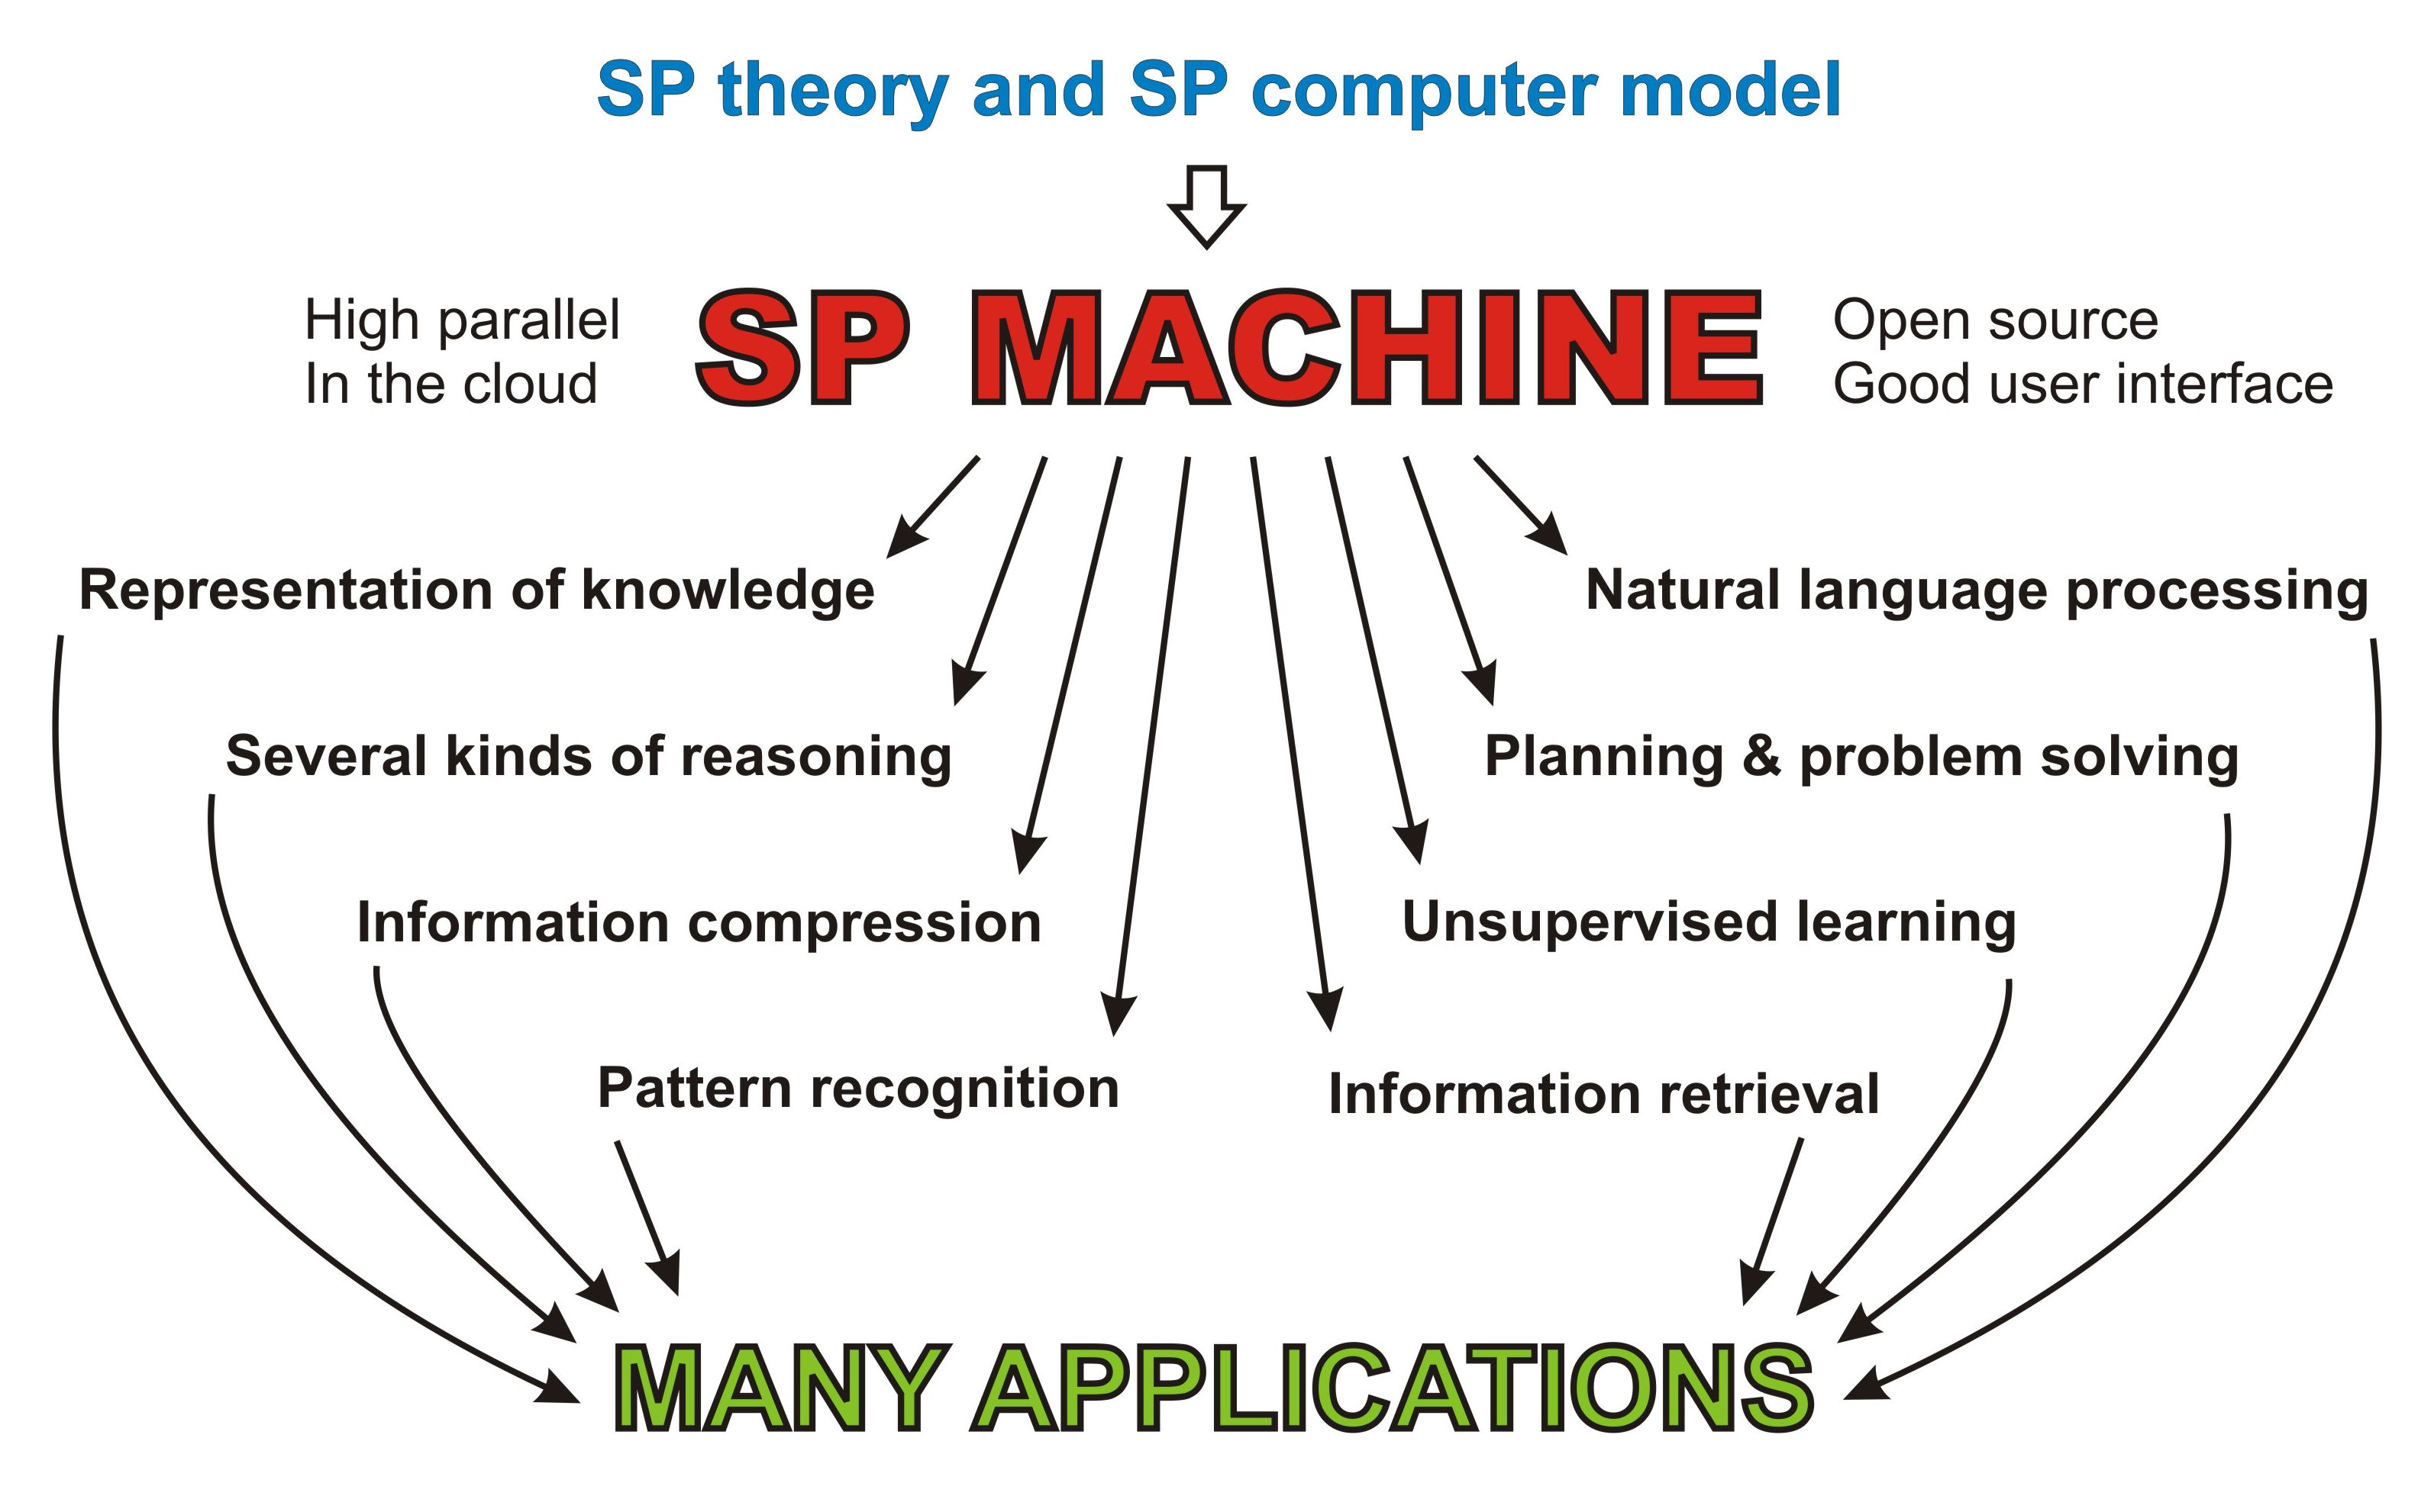
A HIGH-PARALLEL SP MACHINE FOR APPLICATIONS AND FOR RESEARCH

Slide 4
SIMPLIFICATION, INTEGRATION, AND INFORMATION COMPRESSION
■ Simplification and integration. The SP theory of intelligence is a unique attempt to simplify and integrate observations and concepts across artificial intelligence, mainstream computing, mathematics, and human learning, perception and cognition.
■ Information compression is a unifying theme—there is abundant evidence for the importance of information compression in human learning, perception, and cognition.

Slide 5
WHAT ABOUT “DEEP LEARNING”?
■ There are at least 14 significant problems with deep learning.
■ The SP system provides good solutions to all 14 problems.
■ The SP system has a much wider explanatory range than deep learning.
■ The SP system provides a much firmer foundation for the development of general, human-level artificial intelligence.

Slide 6
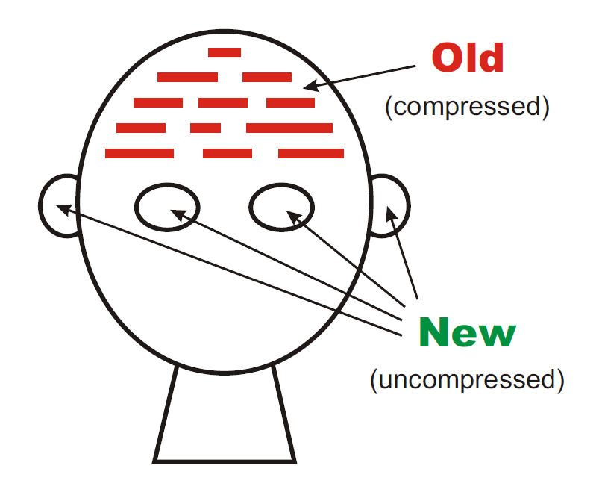
OUTLINE OF THE SP SYSTEM
The SP theory is conceived as a brain-like system that receives New information and compresses some or all of it to create Old information .

Slide 7
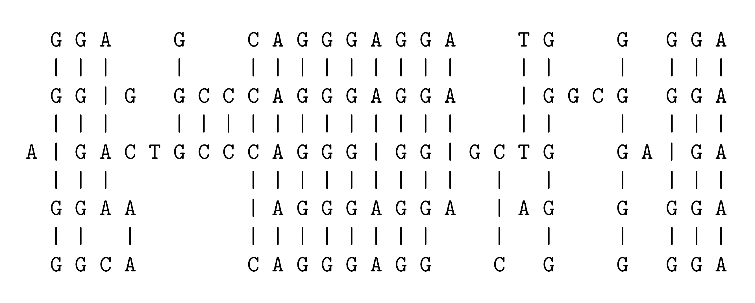
A MULTIPLE ALIGNMENT FROM BIOINFORMATICS
■ “Stretching” of sequences in a computer brings matching letters into line.
■ Heuristic methods are needed because the search is complex.
Notes:
A widely-used technique for the analysis of DNA is to arrange two or more sequences so that matching bases and subsequences of bases are aligned, as shown in this figure.
In the SP theory, this idea has been borrowed and adapted. The main change is the distinction between ‘New’ and ‘Old’ patterns, with the goal of finding multiple alignments that enable New patterns to be encoded economically in terms of Old patterns.

Slide 8
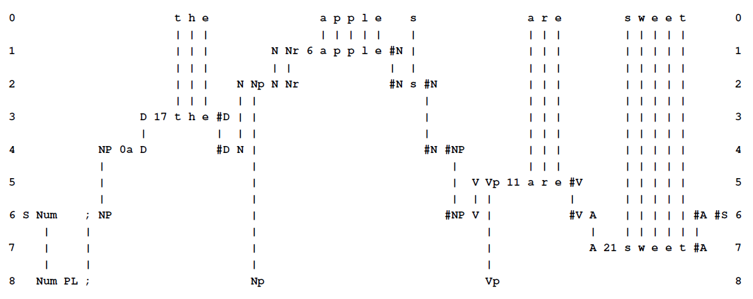
AN SP-MULTIPLE-ALIGNMENT
■ The powerful concept of SP-multiple-alignment is borrowed and adapted from bioinformatics.
■ It promises human-like versatility and adaptability in
intelligence.

Slide 9
VERSATILITY AND ADAPTABILITY IN THE SP SYSTEM
■ Unsupervised learning.
■ Representation and processing of diverse forms of knowledge.
■ Natural language processing.
■ Pattern recognition.
■ Information storage and retrieval.
■ Several kinds of reasoning.
■ Planning and problem solving.
■ Information compression.
■ Modelling human perception and cognition.
■ Modelling neural structures and processes.

Slide 10
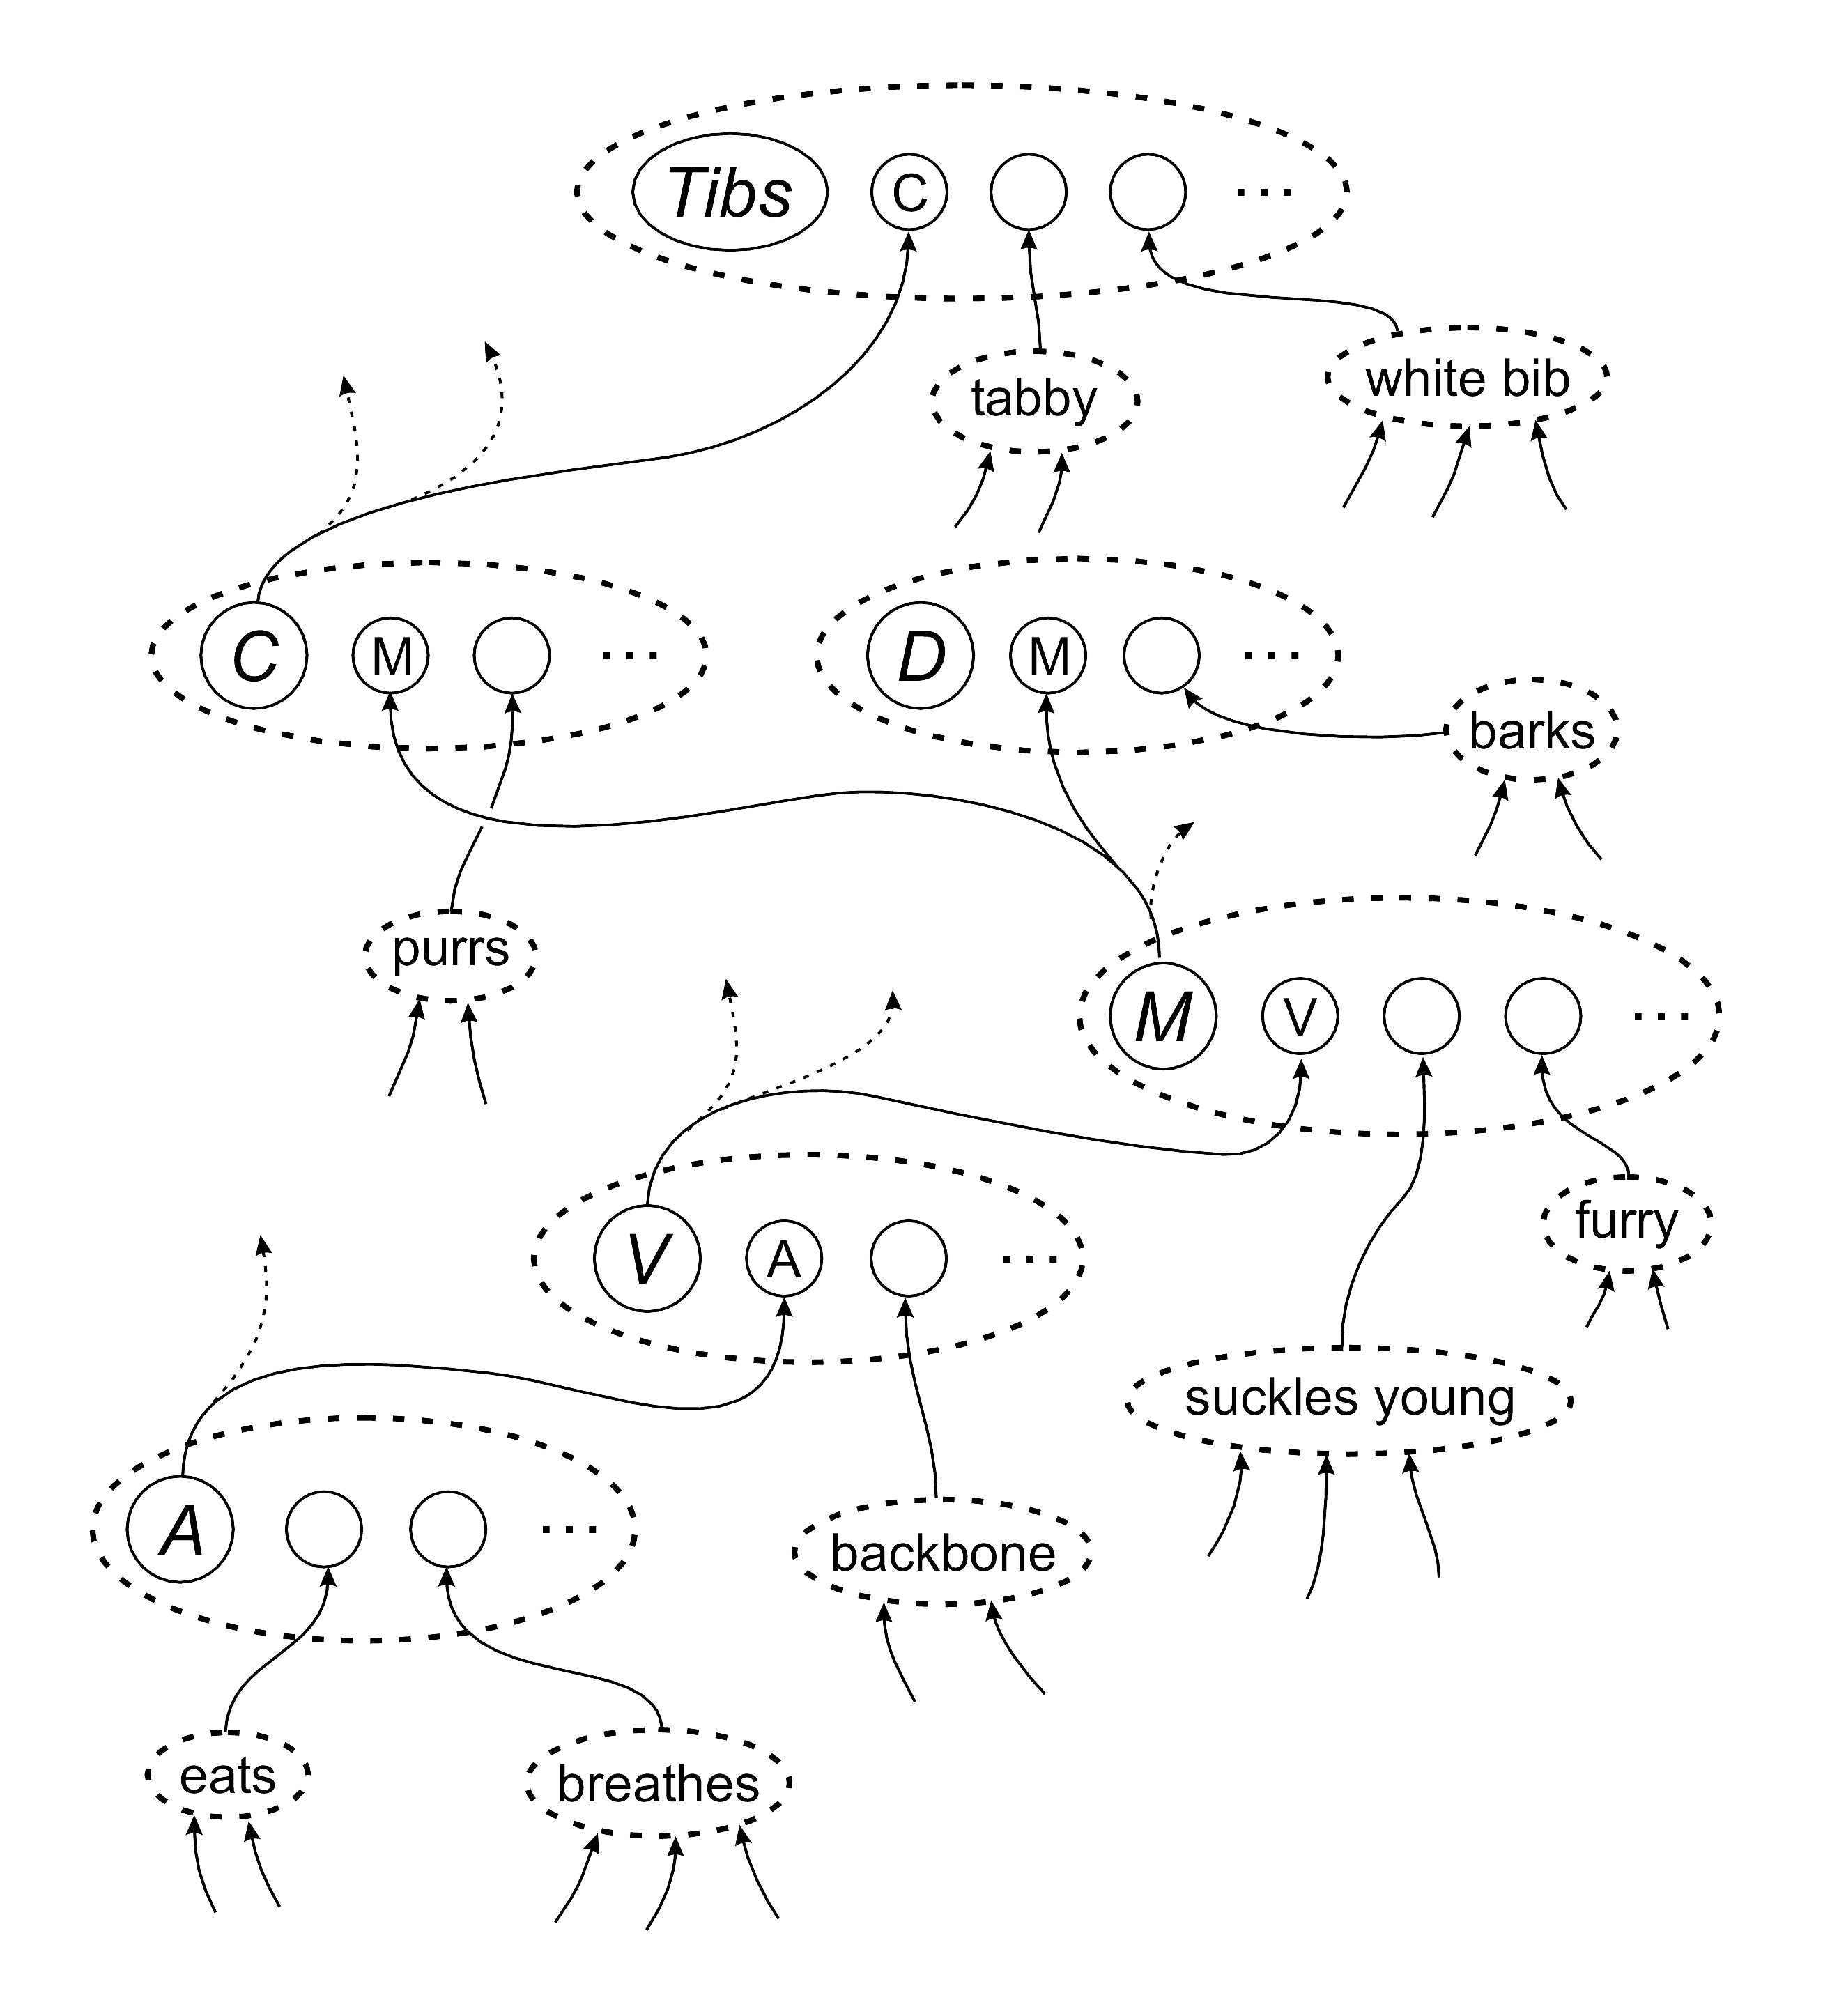
SP-NEURAL
■ SP patterns may be expressed in an adapted version of Donald Hebb’s concept of a cell assembly.
■ This is quite different from “artificial neural networks” that are popular in computer science.
■ Learning in the SP system is quite different from “Hebbian” learning.

Slide 11
POTENTIAL BENEFITS AND APPLICATIONS
■ Helping to solve nine problems with big data (paper in IEEE Access).
■ Autonomous robots (paper in IEEE Access).
■ Computer vision (paper in SpringerPlus).
■ Intelligent databases (paper in Data & Knowledge Engineering).
■ Medical diagnosis (paper in Decision Support Systems).
■ Others (paper in Information):
  ■ Natural language processing.
  ■ Software engineering.
  ■ Bioinformatics.
  ■ And several more.

Slide 12
FURTHER INFORMATION
■ www.cognitionresearch.org/sp.htm .
■ Contact:
  ■ jgw@cognitionresearch.org,
  ■ +44 (0) 1248 712962,
  ■ +44 (0) 7746 290775.

